Slide 1

Intro to Python
By LadueCS
Notes:
Ask everyone to turn on their video.
Ask everyone in the group to introduce themselves.

Slide 2
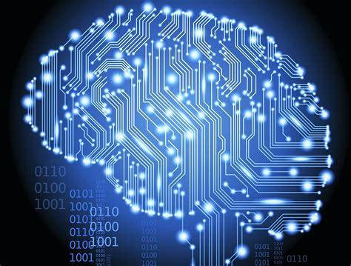
What is computer science?
Computer science is the science of telling a computer how to do a certain task.
CS is a very vast subject, encompassing topics such as algorithms, machine learning, computer engineering, computer graphics, and much more!
Notes:
For example, ...
Show https://en.wikipedia.org/wiki/Computer_science#Fields to demonstrate how broad CS is.

Slide 3
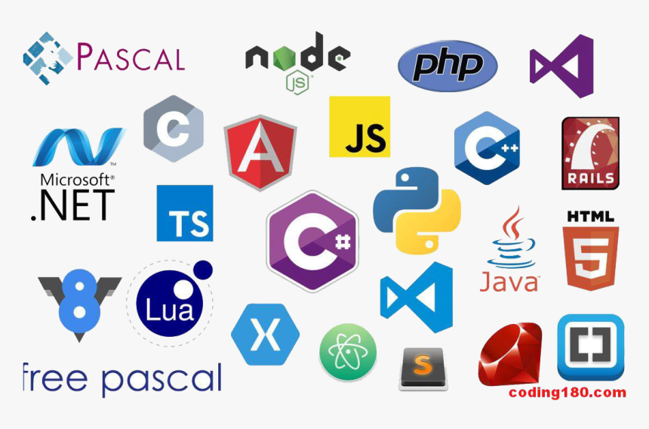
What is a programming language?
Like human languages, there are many different programming languages we can use to communicate with the computer.
Some common ones are:
Python: A simple, elegant language with a large variety of uses
JavaScript: the language that powers the web
Java: A language useful for writing apps
Notes:
More commentary about the programming languages:
Python used in this club
Java used currently in the high school’s AP CS class
etc.

Slide 4

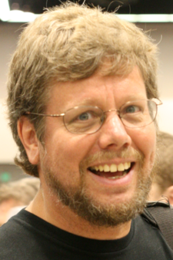
What is Python?
Python was created by Guido van Rossum and first released in 1991
Named after TV show Monty Python, not the snake
Designed to be simple and readable
Python has a huge library of code for many tasks
One of the top three most popular languages
Notes:
Ask if anyone has used Python before.
^^^^^

Slide 5
What we’re going to be doing
We are going to be making a fun tic-tac-toe game using Python to learn computer science over the next few weeks!
Later on, we will branch off into other CS topics such as web design and video game development.
Notes:
We will split into small groups, with a high school student leading each group. Each group will work on their own project using a collaborative code editor similar to Google Docs.
Does anyone else have other particular topics that they’re interested in?

Slide 6
Python topics
Input / output
Variables
Operators
If / else
Loops
Functions
Data types
Using libraries
Notes:
General programming topics (principles universal to almost any computer language)
If you’re familiar with scratch, you should already have some experience with these concepts.

Slide 7

Questions?

Slide 8


Everyday apps that use Python
Netflix
Dropbox
Uber
Instagram
Spotify
Reddit
Pinterest
YouTube
Notes:
Ask if anyone has used any of these apps before.
Also good to check if everyone’s not already fallen asleep.

Slide 9
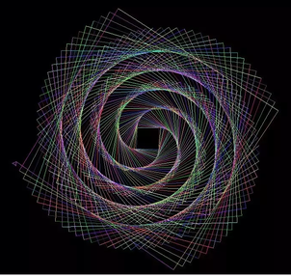
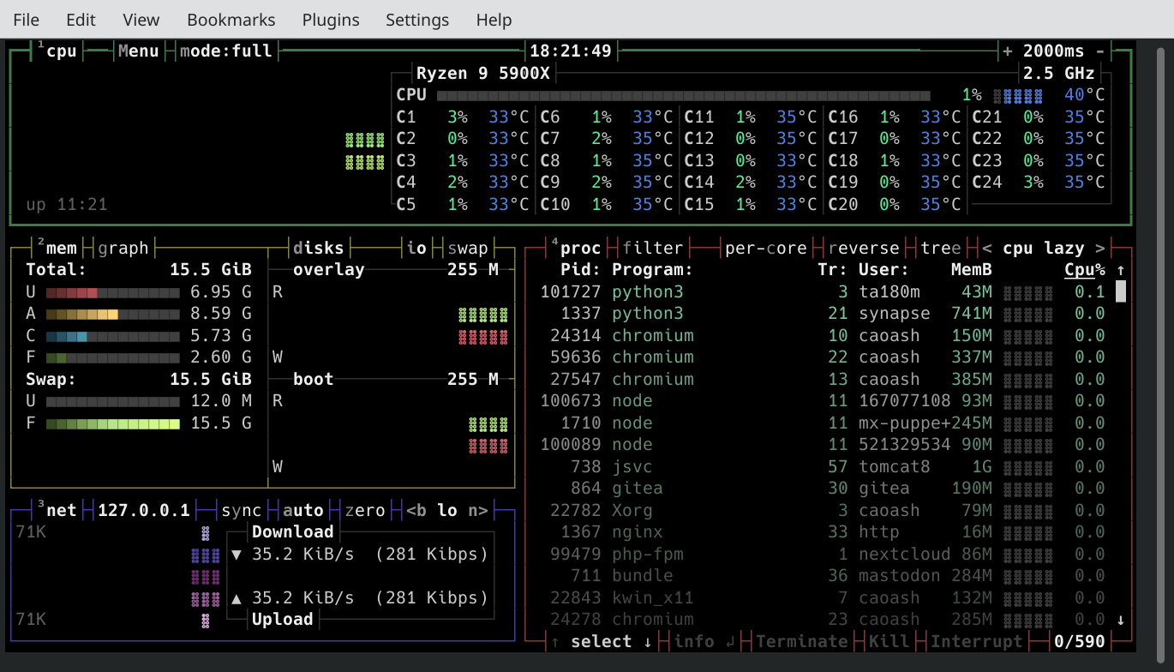
Cool Python things
2048 in Python
Distinguishing between cats and dogs
bpytop system monitor in Python
Notes:
Now for some cool stuff!!!
Skip the second and third things because we don’t have that much time.

Slide 10
Good Python Resources
https://codingbat.com/python
https://www.learnpython.org/
https://wiki.python.org/moin/BeginnersGuide/NonProgrammers (lots of good tutorials)
https://docs.python.org/3/tutorial/index.html (advanced)

Slide 11
Collaborative editing
https://repl.it/
Similar to Google Docs
You need to make an account
https://calc.exozy.me/
Very powerful online editor
Create account with secret token “qNVf3hTTGdoXU1fG”

